Slide 1


Blockchain Technology: A
Revolution in Data Management
Blockchain technology has emerged as a transformative force across various industries. Its decentralized and secure nature offers a revolutionary approach to managing data, transactions, and information. This presentation explores the fundamental concepts of blockchain, its applications, and its potential to reshape the future of technology.
- Snigdha Mamidala (22071A6792)

Slide 2
The Foundations of B lockchain
At its core, blockchain is a distributed ledger technology that enables secure and transparent recording of transactions across a network of computers. It consists of a chain of blocks, each containing a set of transactions. These blocks are linked together cryptographically, forming an immutable and tamper-proof record. Each block contains a timestamp, a hash of the previous block, and transaction data. The blockchain network is secured through cryptography and consensus mechanisms, ensuring data integrity and trust.
1
Data S torage
Blockchain stores data in blocks, each containing a set of transactions. These blocks are linked together in a chain, creating a chronological record of transactions.
2
Decentralization
Blockchain is decentralized, meaning it's not controlled by a single entity. Instead, it's distributed across a network of computers, making it resistant to censorship and manipulation.
3
Immutability
Once a transaction is recorded on the blockchain, it cannot be altered or deleted. This immutability ensures the integrity and reliability of the data.

Slide 3

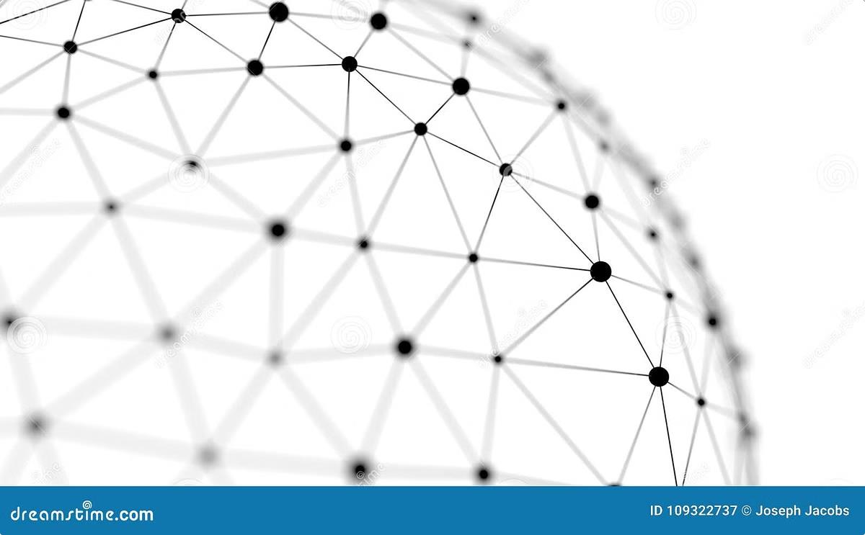
Key Characteristics of Blockchain
Blockchain technology possesses several key characteristics that set it apart from traditional systems. These features contribute to its robustness, security, and wide- ranging applications. These include:
1
Transparency
All transactions on a blockchain are publicly viewable, promoting transparency and accountability.
This provides a shared and auditable record of events.
2
Security
Blockchain's decentralized nature and cryptographic principles make it highly secure, resistant to hacking attempts and data breaches. The use of encryption ensures the confidentiality and integrity of data.
3
Efficiency
Blockchain can streamline processes by eliminating intermediaries and automating transactions. This reduces costs and speeds up transaction processing.

Slide 4
B lockchain Consensus Mec hanisms
To ensure the integrity of the blockchain and validate transactions, a consensus mechanism is used. This mechanism allows all nodes in the network to agree on the validity of transactions and the order in which they are added to the blockchain. Several consensus mechanisms exist, each with its advantages and drawbacks. Some common types include:
Proof-of-Work (PoW) Proof-of-S take (PoS )
Delegated Proof-of-S take (DPoS )
PoW requires miners to solve complex computational puzzles to verify transactions. This process consumes significant energy, but it provides a high level of security.
PoS allows validators to participate in consensus based on the amount of cryptocurrency they hold. This mechanism is more energy-efficient than PoW, but it may be susceptible to attacks from large stakeholders.
DPoS allows users to delegate their voting rights to elected representatives who are responsible for validating transactions. This simplifies the process and reduces energy consumption.

Slide 5
Blockchain Applications and Use Cases
Blockchain's transformative potential extends beyond cryptocurrency. It has wide-ranging applications across industries, offering
solutions to long-standing challenges and creating new opportunities. Some key use cases include:
Supply Chain Management
Blockchain can track goods from origin to destination, improving transparency, reducing fraud, and enhancing efficiency. This is especially relevant for industries with complex supply chains, such as food, pharmaceuticals, and manufacturing.
Healthcare
Blockchain can secure patient data, enabling better data management and sharing among healthcare providers. This promotes privacy, enhances patient safety, and improves the efficiency of healthcare systems.
Finance
Blockchain facilitates faster and cheaper international payments. It can also improve the efficiency of financial transactions and reduce the risk of fraud.
Identity Management
Blockchain can create secure and verifiable digital identities, reducing identity theft and streamlining identity verification processes.

Slide 6


Cryptoc urrencies and B lockchain
Cryptocurrencies, such as Bitcoin and Ethereum, are a prominent application of blockchain technology. These digital currencies operate independently of central banks and rely on blockchain for secure transactions and decentralized control.
Cryptocurrencies enable peer-to-peer transactions, bypassing traditional financial
institutions. They offer a decentralized and potentially more accessible alternative to traditional currencies.
Cryptocurrency | Features
Bitcoin (BTC) | First and most well-known cryptocurrency, known for its security and decentralized nature.
Ethereum (ETH) | A platform for decentralized applications (DApps) and smart contracts, offering a flexible and programmable blockchain.

Slide 7


B lockchain and S mart Contracts
Smart contracts are self-executing contracts stored on the blockchain. They automate agreement terms and enforce them automatically, reducing the need for intermediaries. These contracts can be used for a variety of purposes, such as:
Automated Payments
Smart contracts can automate payments when specific conditions are met, such as the delivery of goods or services.
Decentralized Exchanges
Smart contracts enable the creation of decentralized exchanges, facilitating direct trading of assets without the need for central authorities.
S upply Chain Tracking
Smart contracts can record and verify events in a supply chain, ensuring transparency and accountability.

Slide 8

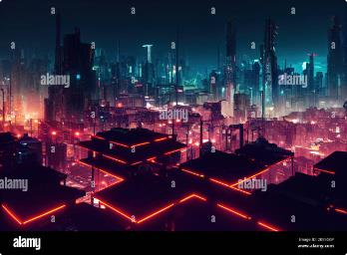




Challenges and Limitations of Blockchain
While blockchain technology offers significant advantages, it also faces challenges and limitations. These are areas where further development and
innovation are needed to fully unlock its potential. Some of the notable challenges include:
Scalability
Blockchain networks can struggle to handle a high volume of transactions, limiting their ability to scale to meet the demands of large-scale adoption.
Energy Consumption
Proof-of-Work consensus mechanisms, particularly Bitcoin, consume significant energy, raising concerns about environmental sustainability.
Regulation
The lack of clear regulatory frameworks for blockchain and cryptocurrency poses challenges for businesses and individuals seeking to use this technology.
Complexity
Blockchain technology can be complex to understand and implement, requiring specialized expertise and technical knowledge.

Slide 9
B lockchain Trends and Future Developments
Blockchain technology is constantly evolving, with new trends and innovations emerging regularly. These advancements aim to
address challenges, enhance performance, and expand the range of applications. Some key trends include:
1
Interoperability
Efforts to connect different blockchains and enable communication between them are underway, facilitating seamless data exchange and interoperability between various systems.
2
Privacy E nhancing Technologies
Developments in privacy-enhancing technologies are aiming to improve data privacy and security within blockchain networks, addressing concerns about data transparency and confidentiality.
3
Decentralized Finance (DeFi)
DeFi is a rapidly growing sector that leverages blockchain technology to provide financial services in a decentralized and accessible manner, challenging traditional institutions and offering new opportunities.
4
Non-Fungible Tokens (NFTs)
NFTs are unique digital assets that can represent ownership of digital or physical items. They are gaining popularity in art, gaming, and other industries, transforming how value is created and exchanged.

Slide 10

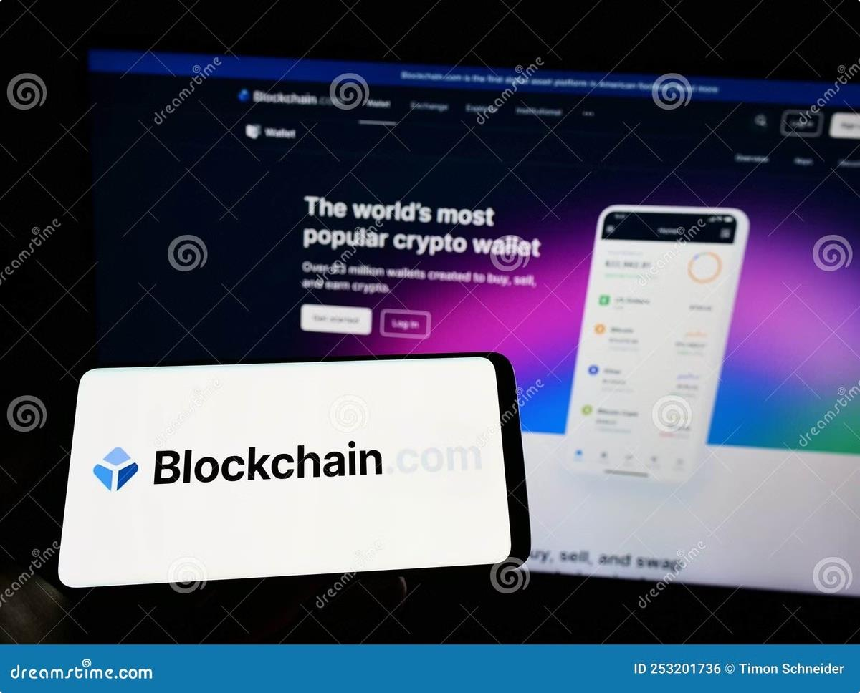
Conclusion and Key Takeaways
Blockchain technology is revolutionizing the way we manage data, conduct transactions, and interact with information. Its decentralized, secure, and transparent nature offers a powerful alternative to traditional systems, with applications across various industries. While challenges remain, the ongoing development and innovation in this field promise to unlock further potential and transform the future of technology.

Slide 11
Thank You

